Slide 1
3 LLM Applications Every Data Scientist Should Know

Slide 2
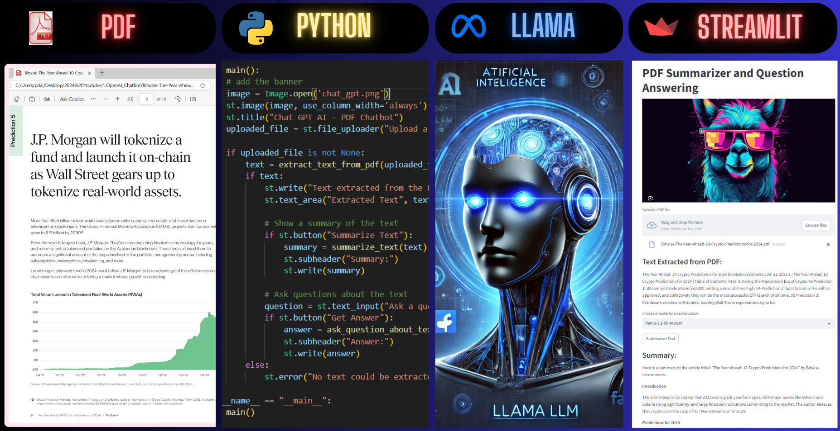
1. Pointing your llm to text (e.g., PDFs)and analysing data
LLMs enable businesses to extract valuable insights from large documents using natural language queries:
Automatically generate summaries of complex documents
Answer specific business questions like, "What were total sales this week?"
Perform sentiment analysis to understand customer feedback or trends
And more...
Automating data extraction becomes seamless with LLMs:
Extract key contract details such as titles, sales amounts, purchasers, and more
Links:
Using ChatGPT API: https://youtu.be/yq803m5ESXI
Using BERT & T5 Local: https://youtu.be/j_1MYThJOFI
Using Gemini API: https://youtu.be/TLzrmrOI3s4
Using Llama API: https://youtu.be/Gi-2a05hbzo
Notes:
Summary of the pdf
what is the sentiment of this text in 2 sentences?
When was this published?
Who wrote this?

Slide 3
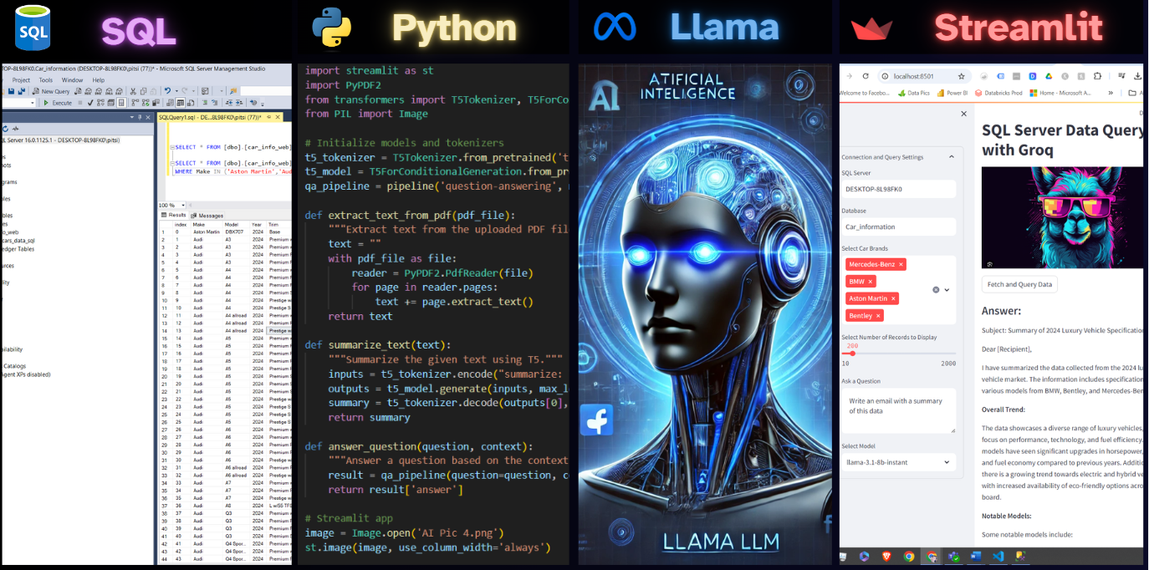
2. Pointing your llm to SQL and analysing data
LLMs allow businesses to query databases using natural language:
Easily retrieve summaries of sales, e.g., "What was the sales summary last week?"
Compare revenue for different categories, e.g., "How much revenue did we make for X category this week compared to last week?"
Generate detailed reports, e.g., "Show me all sales that occurred last week.“
LLMs can streamline data updates:
Business can easily update databases without the need for complex forms or interfaces, using natural language commands.
Links:
Using LLama API: https://youtu.be/UyDVbQkkb-0
Using OpenAI – ChatGGPT API: https://youtu.be/YT-FM1F8DXU
Notes:
what was the total sales for order dates in June?
give me a product report in terms of sales

Slide 4
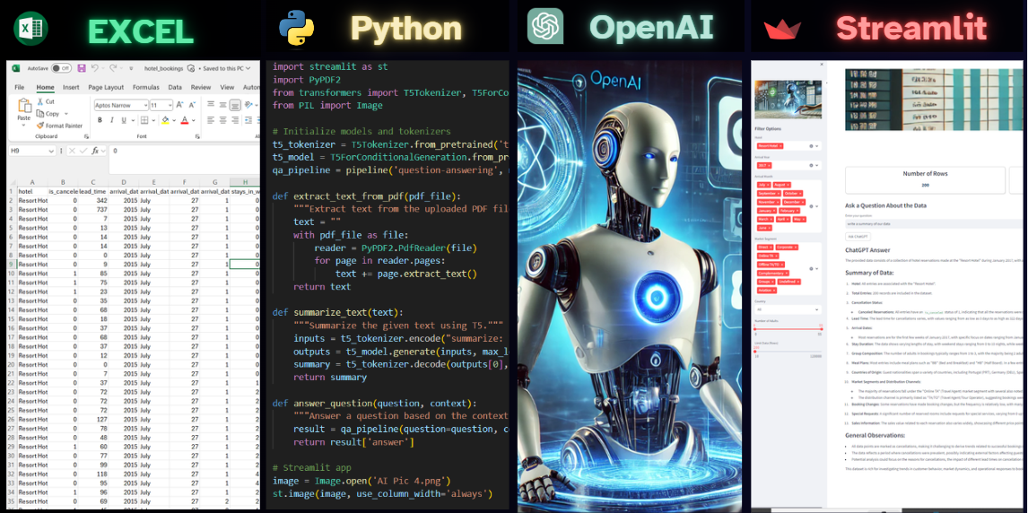
3. Pointing your llm to Excel and analysing data
LLMs provide businesses with the ability to analyze large Excel files quickly and efficiently:
Summarize Excel sheets to highlight key business metrics
Compare revenue over different periods or categories, e.g., "How much revenue did we make for X category this week versus last week?"
Retrieve specific transactions or records, e.g., "Show me all sales from last week."
Links:
Using OpenAI – ChatGPT API: https://youtu.be/9DIuwT_lKjQ?si=AgLLbq4kJp7-En3Q
Notes:
write a summary of this data
compare may and june in terms of total sales. Analyse their performance

